Slide 2
The petroleum research centres (PETROCENTRES)
The programme was established in 2013 and is administered by the Research Council of Norway.
The centres work with challenges of great national importance and receive public funding for a maximum period of eight years.
Consists of research institutions and industry partners and involves a long-term and targeted research effort at a high international level.
Main objective ‘Sustainable management of the environment, resources, nature and areas’ and more specifically, the sub-goal “Responsible management of Norwegian petroleum resources in areas opened for petroleum activities”.
Long-term research, international level, and address specific challenges related to the exploitation of Norwegian petroleum resources.
NCS2030 was established as a Petrocentre in 2021.
Notes:
https://www.forskningsradet.no/en/apply-for-funding/funding-from-the-research-council/Petrosenter/
https://www.regjeringen.no/en/topics/energy/energy-and-petroleum-research/petrosenter/id2696216/

Slide 3
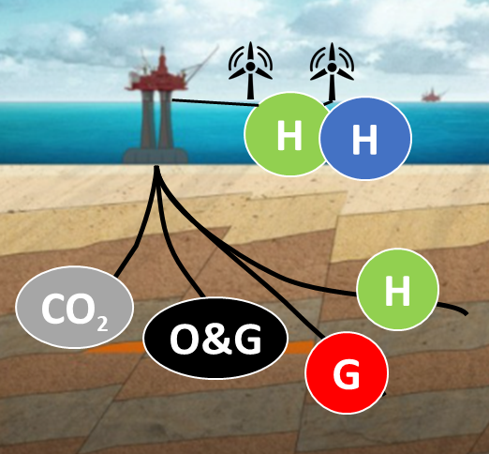

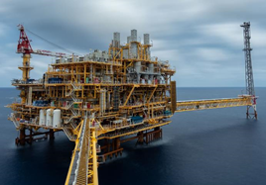

The vision of the NCS2030 centre is to facilitate an energy-efficient, multi-purpose utilization of the subsurface of the NCS into a “Sustainable Subsurface Value Chain”.
Subsurface Energy Systems
Education
Outreach
Sustainable Subsurface
Value Chain
Net-zero emission production
Society
Collaboration
Innovation
Digitalization

Slide 4
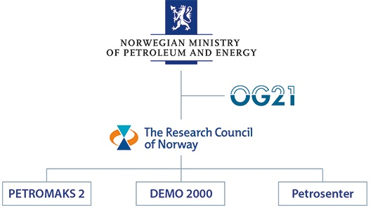


8 years research centre (2022-2029)
The primary objective of NCS2030 is to fill knowledge gaps and provide solutions for maximizing value creation of subsurface resources to reach the Net Zero Emission (NZE) goals on the Norwegian Continental Shelf (NCS).

Slide 5
Governance
structure
General Assembly
Board
TC
Task force …
Task force 2
Scientific Advisory Committee (SAC)
Task force 1
WP8
Centre Management
(CM)
Innovation Committee
WP7
Education
and outreach
Researchers, PhDs / Postdocs
WP1
WP2
WP3
WP4
WP5
WP6

Slide 6
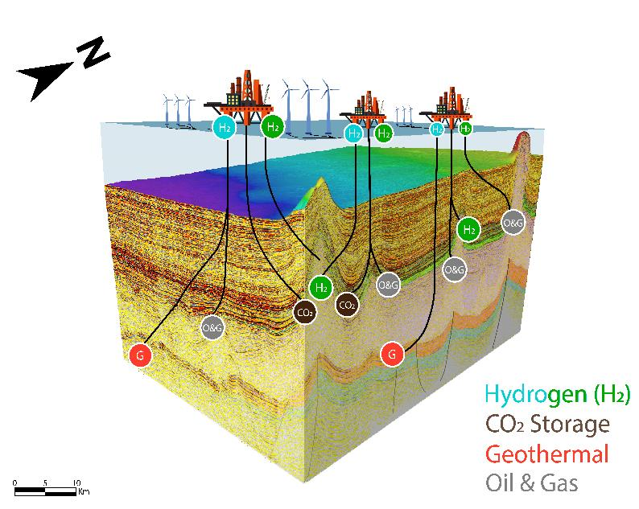
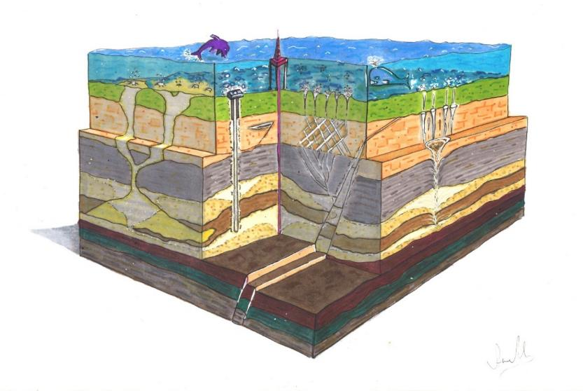





The team: More than 70 researchers in 6 scientific and 1 educational work package
WP1: Near field resource evaluation
WP2: Reservoir utilization for energy transition
WP3: Net-zero emission (NZE) production
WP7: Education and outreach
WP4: Efficient water management
WP5: Digital Subsurface for Improved Decisions
WP6: Energy policy, economy and society

Slide 7
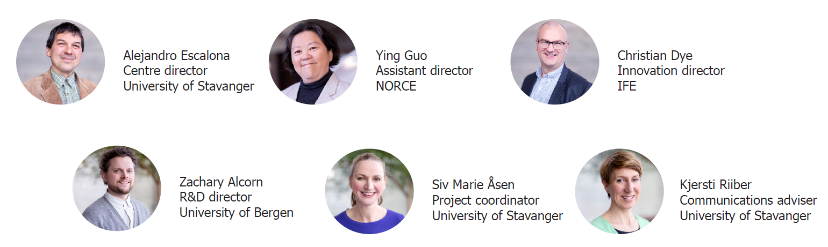
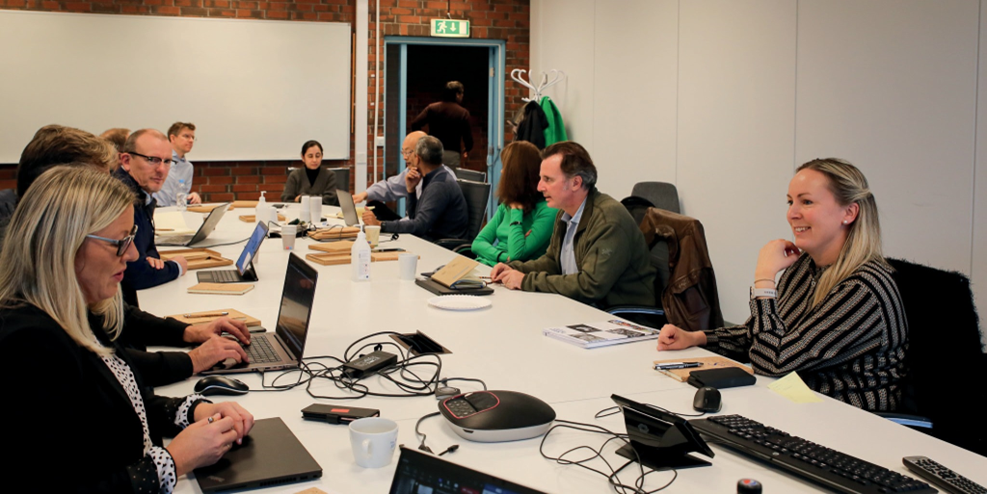
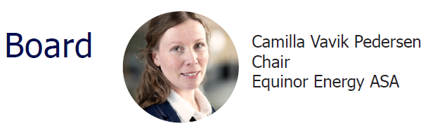



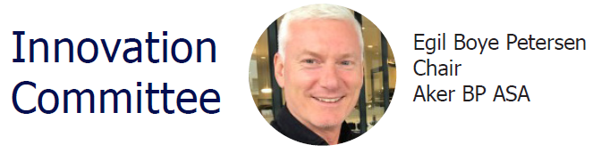
Centre management
All committees established and operational

Slide 8
NCS2030 – key figures
Goal
Contribute to establishing a sustainable subsurface value chains for the Norwegian Continental Shelf ​
Scope
4 main topics, 8 Work packages, 26 projects (2022-)
8 industrial end users, large number of national and international academic collaborators, innovation centres, clusters and SMBs
Collaboration
Budget
300 MNOK (30 M$) for 8 years (2022 – 2029)
Notes:
Contribute to create sustainable subsurface value chains on NCS

Slide 9











User partners & observers

Slide 10
Acknowledgement
The author(s) acknowledge the Research Council of Norway and the industry partners of NCS2030 – RCN project number 331644 – for their support.

