Slide 1
UIS Masters:
Job-training opportunity with the County Governor ?

Slide 2
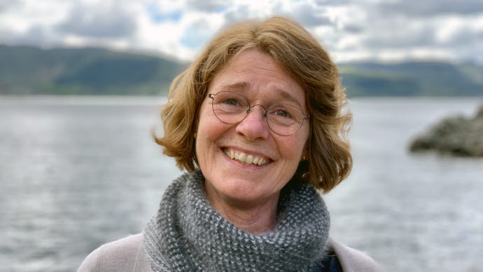
Rogaland’s County Governor
The King’s representative for the National Assembly and the National Government.
Lone plays an important link between the local municipalities and the Central State Institutions.
Lone Merete Solheim

Slide 3
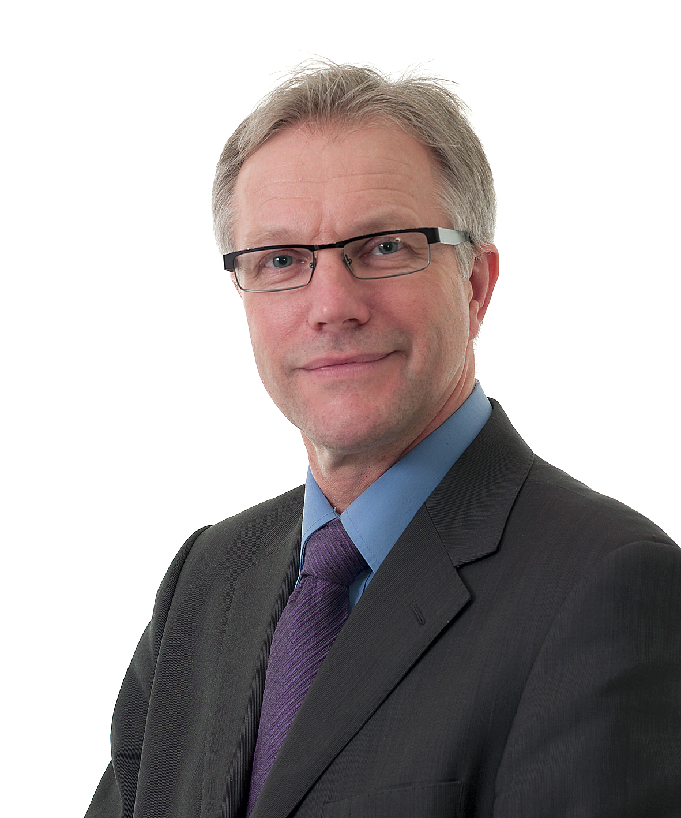
We conduct the overall operational duties on behalf of the House of King, under the department’s supervision of «Kommunal- og moderniseringsdepartementet»,
among 10 other departments.
Harald Thune
Governor’s Assistant

Slide 4
Rogaland’s County Governor
Our team consists of 150 employees within the departments of:
HEALTH/SOCIAL WELFARE
EDUCATION
AGRICULTURE
ENVIRONMENT
COMMUNITY/SAFETY
Collaboration across the office is vital, hence our planning groups are in constant cooperation with a supervisory team.
Notes:
Several regions in Rogaland are growing rapidly, especially Nord-Jæren, but also areas north of Boknafjorden. This leads to pressure on farmland. When the road connection Ryfast opens in 2019, linking Nord-Jæren and Ryfylke together, it is estimated that there will be significant growth there, especially in the municipality of Strand. We are pilot county for the coordination of government objections. The project “God oppvekst i Rogaland” provides guidance throughout the work undertaken in office, with “Sjumilssteget” a central part of the project.

Slide 5
The County Governor’s Environmental Department
Our work commitment:
Nature Conservation:
Classic Nature Protected Areas
New National Framework; Wind Power
County and Regional Water Resources plan
Pollution and Climate:
Polluted sediments
Industrial pollution control license
Climate gas reduction and climate adjustment
Coordination of the regional state institutions:
Supervision for the local development planning

Slide 6
Thinking of appplying?
We can provide the opportunity of connecting you to our extensive network, within the municipalities and across different industries.
Tell us honestly about your main interests and what your true passions are!
Having the SDGs in mind while writing your application, would be splendid!
We are flexible and want to make your stay as pleasant as possible, as much for you as for us.

Slide 7

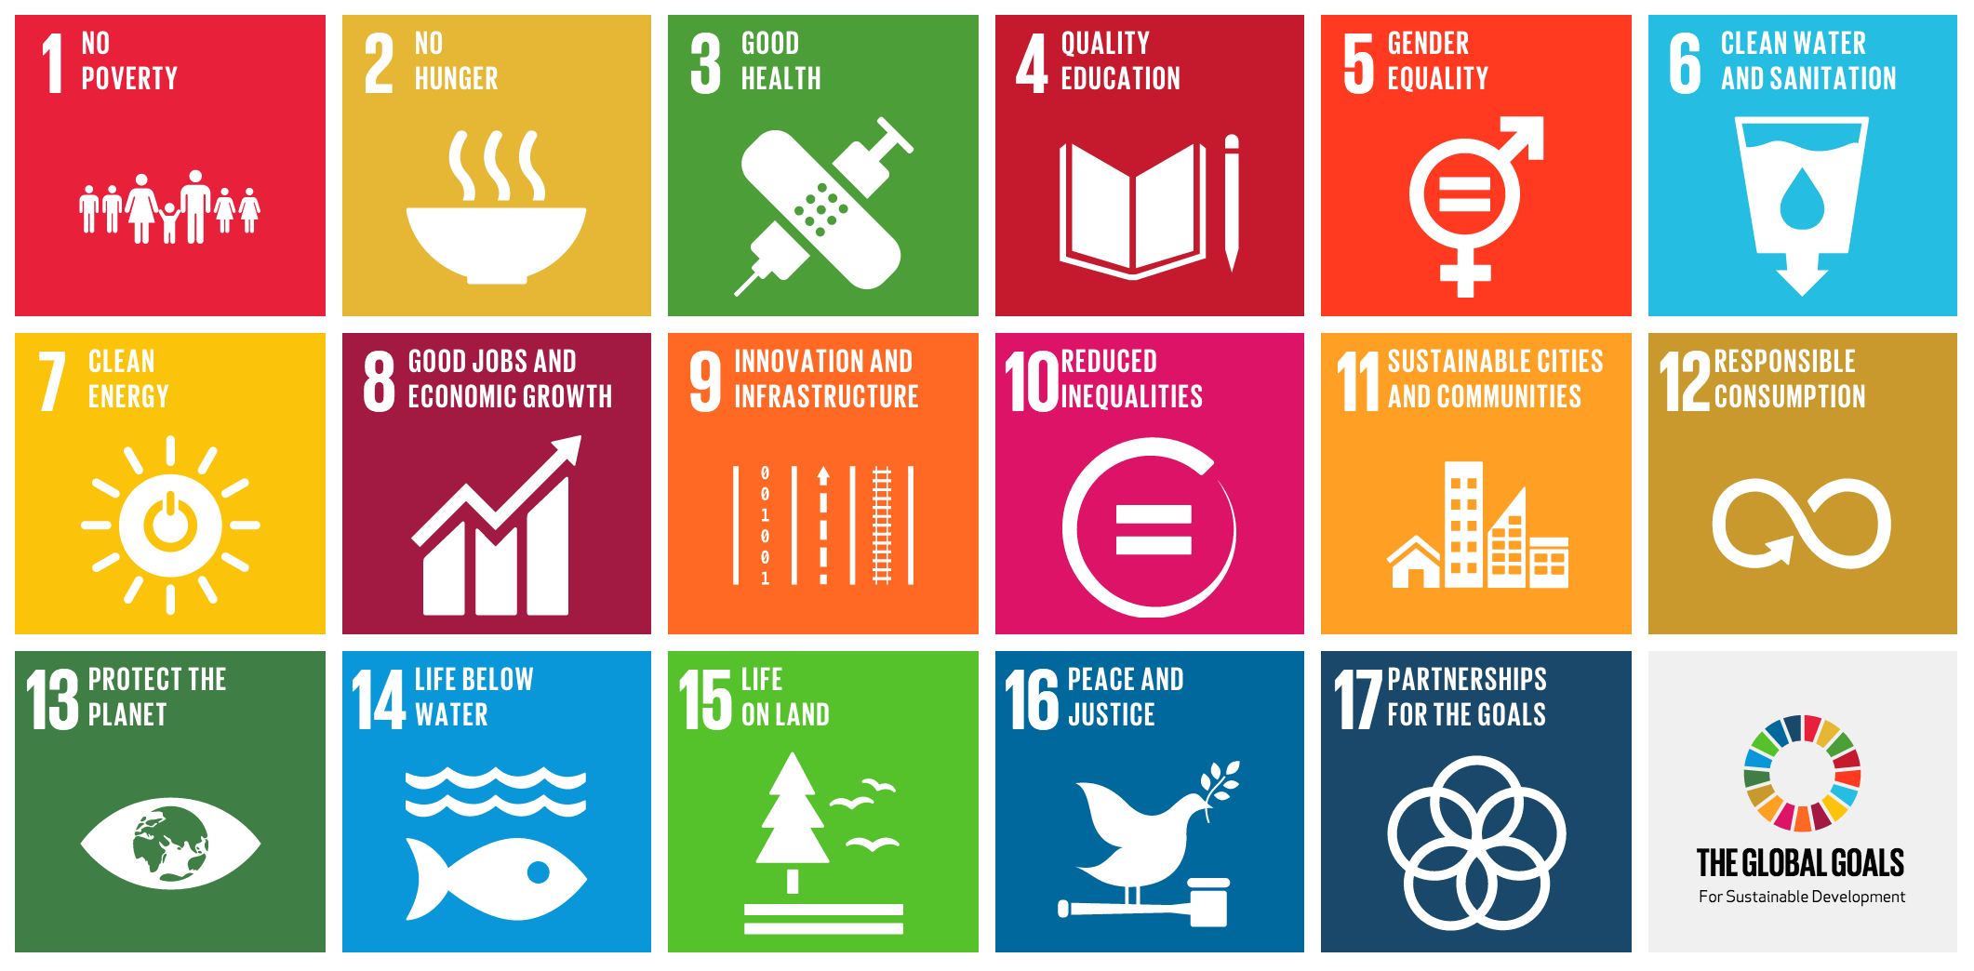
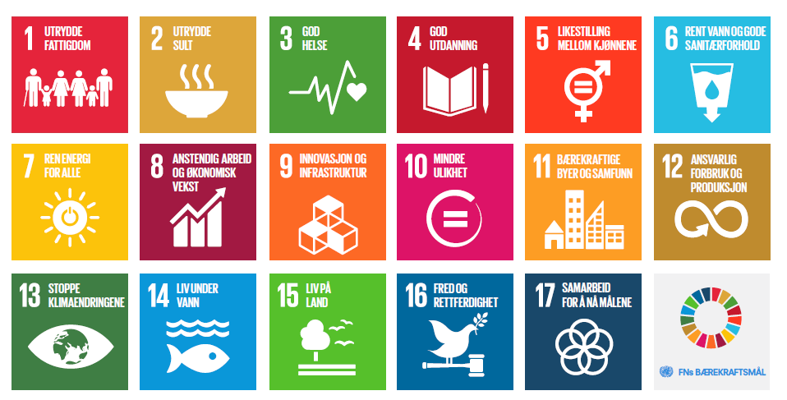

Slide 8
Environment and Nature Department
Classical nature conservation
Redlisted species
Blacklisted species
Water management
Nature Mapping (NIN)
Media strategy for nature
Biodiversity, changing the public’s mindset
Pollution
Marine plastic pollution
Controlling poison from industry
Subsequent use of mineral-sites
Lowering climate-emissions from industry
Areal planning
for sustainable development

Slide 9
We are looking forward to reading your application!!

