Slide 1
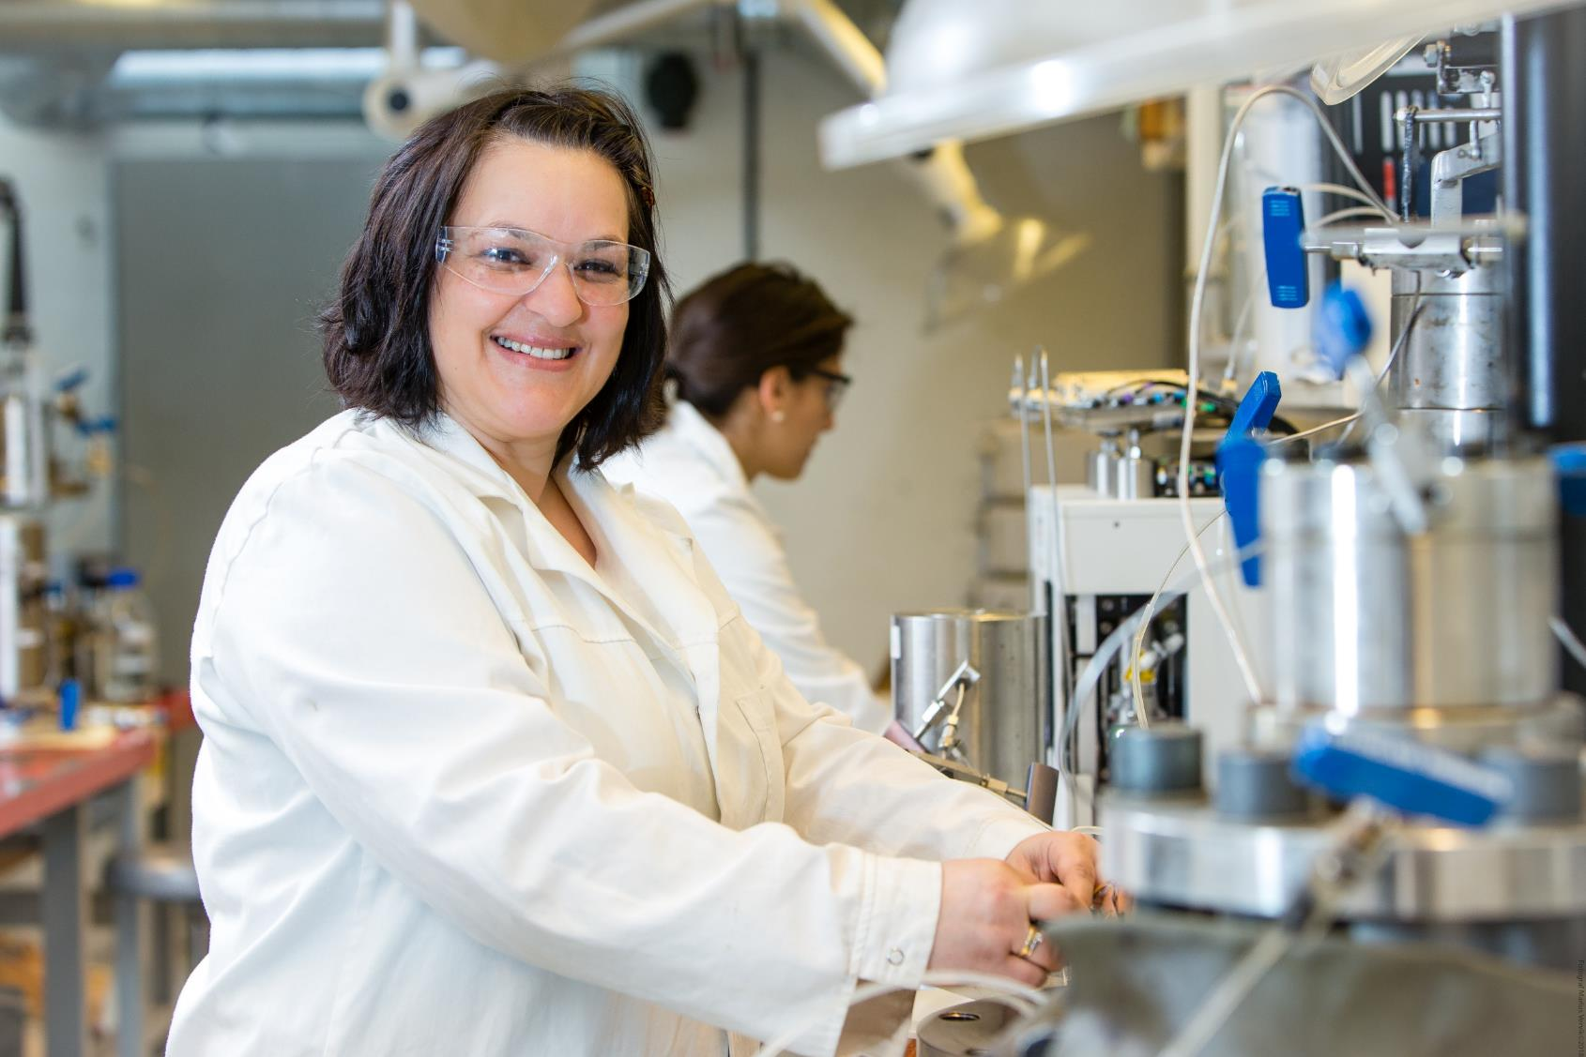

Foto: Marius Vervik

Slide 2
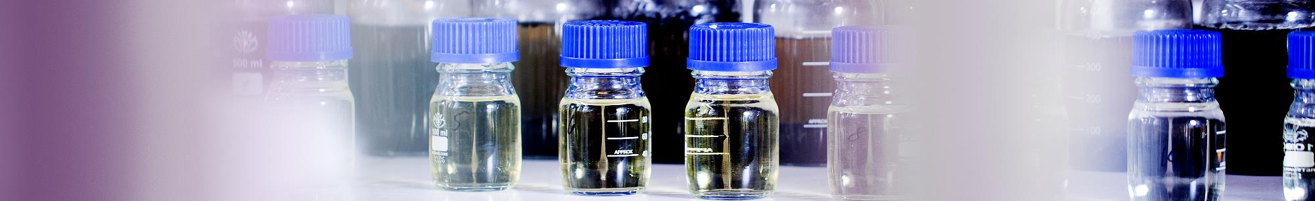
The National IOR Centre of Norway
Improve oil recovery on the Norwegian Continental Shelf
Research and development for field implementation
Cost effective and environmentally friendly technologies
Led by University of Stavanger, with research institutes NORCE and IFE as core partners. 9 oil and service companies, complete the list of collaborators.

Slide 3
Budget
The National IOR Centre of Norway is one of three petrocentres
3 research- and 9 industry partners
~ 50 mill. NOK
  ~ 20 mill. NOK from UiS
  10 mill. NOK from RCN
  2 mill. NOK from each industry partner
5+3 years

Slide 4
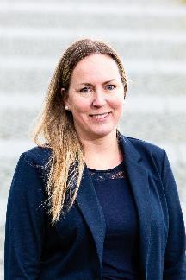
The research themes
1: Mobile and immobile oil and EOR methods
Theme leader Tina Puntervold
Optimize the microscopic and macroscopic displacement efficiency in a porous rock from the chemical and mineral compositions of pore fluids and rock grains, considering the sustained diagenesis and translate this knowledge to industry applications.
Develop methods of upscaling pore and core oil recovery to field scale
Develop methods that can predict transport of chemical compounds from core to field
A fundamental understanding of wettability and its role in porous media flow from pore-, to core and field scale
An understanding of the impact and long term effect of EOR technologies on the reservoir
Evaluate the environmental impact of the EOR methods.

Slide 5
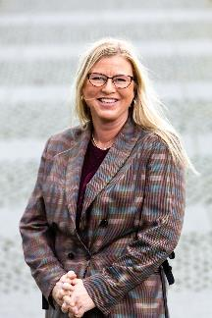
The research themes
2: Reservoir characterisation to improve
volumetric sweep
Theme leader Randi Valestrand
The aim is to develop new methodology that will support the evaluation and decision making for IOR/EOR pilots at the NCS. This addresses the potential of producing the resources in un-swept areas as well as mobilizing the trapped resources in swept areas. The research demonstrates the improved methodology on real field cases.
Further development of tracer technology
Improvement of reservoir simulation tools with regards to IOR/EOR processes
Robust production optimization
Better history matching through improved data assimilation tools
Inclusion of 4D seismic data in ensemble based history matching
Evaluation of economic potential
Investigation of the connection between the reservoir complexity and recovery factor potential

Slide 6
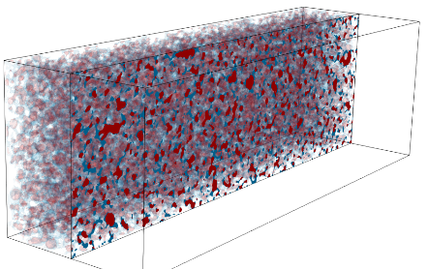
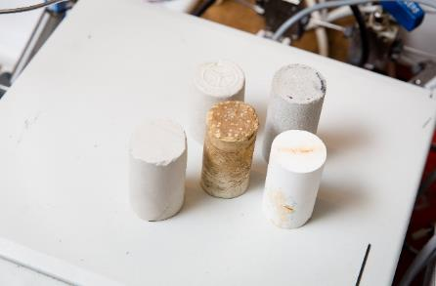
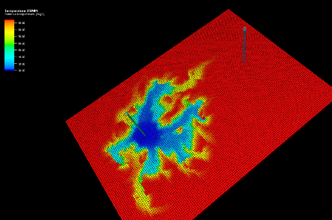
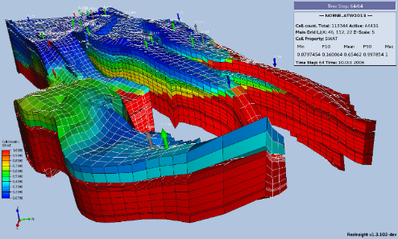
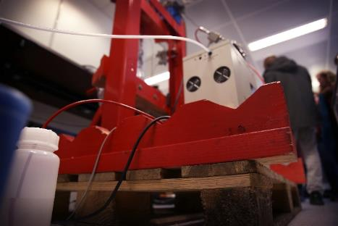
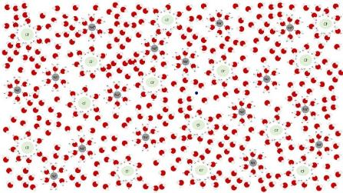
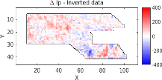


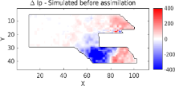
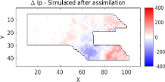

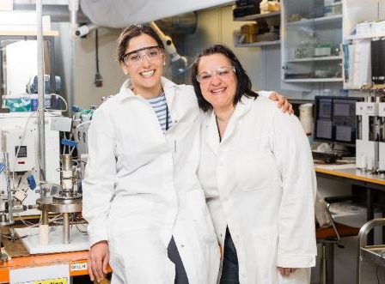
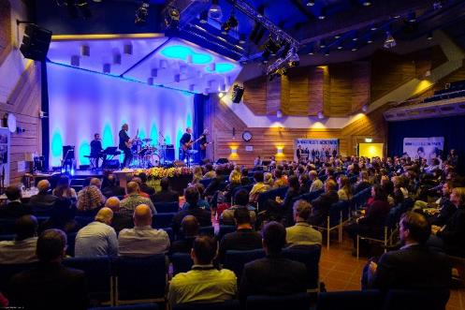

IOR NORWAY
HIGHLIGHTS FROM THE NATIONAL IOR CENTRE OF NORWAY
PORE SCALE SIMULATOR
(BADCHIMP)
IORCORESIM
IORSIM
OPEN POROUS MEDIA (OPM)
LARGE SCALE TESTS
NEW TRACERS
4D SEISMIC DATA
ASSIMILATION FOR IOR
DATA ANALYTICS FOR IOR
ENVIRONMENTAL RISK
ASSESSMENT (ERA)
JOINING FORCES WITH
NATIONAL AUTHORITIES
EDUCATION

Slide 7
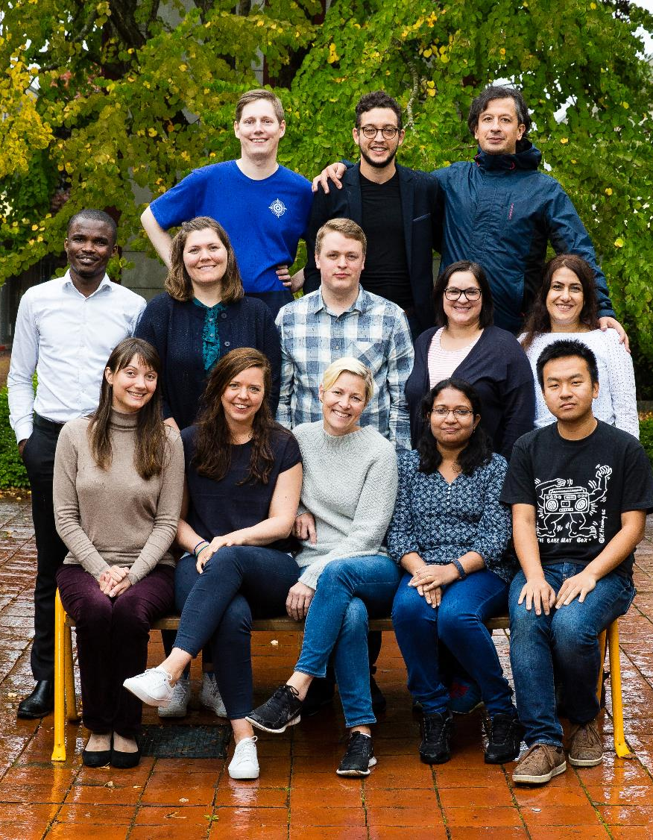
The young talents
29 PhDs and 19 Postdocs
2019:
  5 new post doc positions
  10 new PhD positions

Slide 8
Journal articles 2013-2021

Slide 9
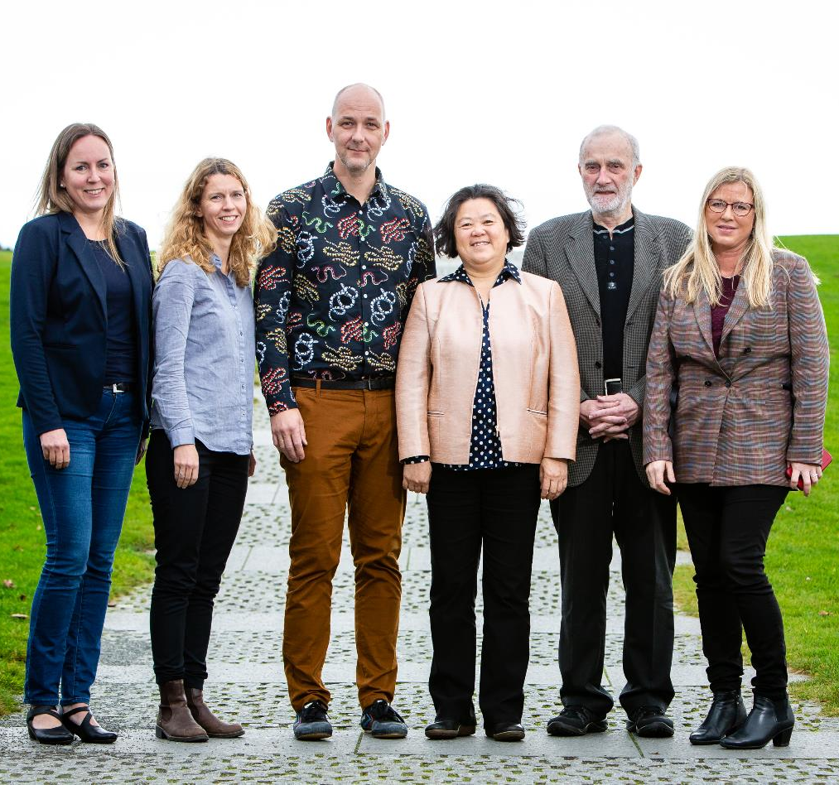
National & international collaborators
UNIVERSITY OF BERGEN
UNIVERSITY OF OSLO
NTNU / UGELSTAD LABORATORY
SINTEF
DTU / GEO / GEUS
TNO
TU DELFT
CORNELL UNIVERSITY
UNIVERSITY OF TEXAS AUSTIN
INSTITUTE FOR THE STUDY OF THE EARTH`S INTERIOR
UNIVERSITÉ DE LYON
ECOLE POLYTECHNIQUE PARIS, FRANCE
NATIONAL CENTER FOR ATMOSPHERIC RESEARCH
SANDIA NATIONAL LABORATORIES
TU BERGAKADEMIE FREIBERG
INSTITUTE OF SCIENCE & TECHNOLOGY, LUXEMBOURG
UNIVERSITY OF MÜNSTER, GERMANY
+++

Slide 10













How we relate to UN’s goals for
sustainable development
Students, PhDs and postdocs play a vital part in the Centre.
No less than 25 per cent of the Centre's budget is reserved for education and training purposes.
The Centre has had an impact on the Norwegian petroleum education, both in terms of recruitment, quality, and international cooperation.
The research conducted by the Centre will, when EOR projects are applied to fields, lead to:
Accelerated and more energy efficient production.
Sustainability due to the utilization of the existing infrastructure.
Solutions to prevent risks of discharges of environmental toxic chemicals.
Sustainable economic growth will require societies to create the conditions that allow people to have quality jobs.
About 180 000 people work in the oil industry in Norway.
To maintain low unemployment rates in Norway, we have to continue producing oil for decades to come.

Slide 11



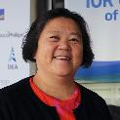









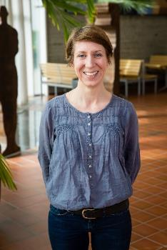



The organization
Robert Moe
Head of Technical Committee
Thierry Laupretre
Chairman of Board
Ann Muggeridge
Leader Scientific Advisory Committee
Ying Guo
Centre Director
Tina Puntervold
Assistant Director
Leader Theme 1
Randi Valestrand
Research Director
Leader Theme 2
Sissel Opsahl Viig
Director of Field Implementation
Aksel Hiorth
Director of Academia & Research
Svein M. Skjæveland
Advisor
Micol Pezzotta
Administrative Coordinator
Arne Stavland
Leader Task 1
Core scale
Udo Zimmermann
Leader Task 2
Nano/submicron scale
Espen Jettestuen
Leader Task 3
Pore scale
Aksel Hiorth
Leader Task 4
Upscaling
Kjersti Riiber
Communications Advisor
Tor Bjørnstad
Leader Task 5
Tracer technology
Ove Sævareid
Leader Task 6
Reservoir simulation
Geir Nævdal
Leader Task 7
Field scale evaluation

Slide 12



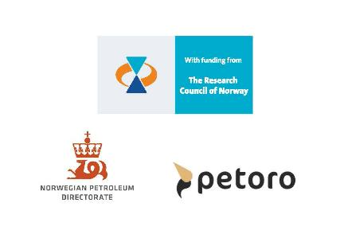





The 2020 user partners and observers:

Slide 13
Acknowledgement
The authors acknowledge the Research Council of Norway and the industry partners, ConocoPhillips Skandinavia AS, Aker BP ASA, Vår Energi AS, Equinor ASA, Neptune Energy Norge AS, Lundin Norway AS, Halliburton AS, Schlumberger Norge AS, and Wintershall Dea, of The National IOR Centre of Norway for support.

